Slide 1

L.L.A.M.A. Inc. (Libraries, Life, and Medical Assistance)
Empowering communities with knowledge and care

Slide 2
L.L.A.M.A Inc. (Libraries, Life, and Medical Assistance)
A multifaceted company that helps people in different ways.

Slide 3

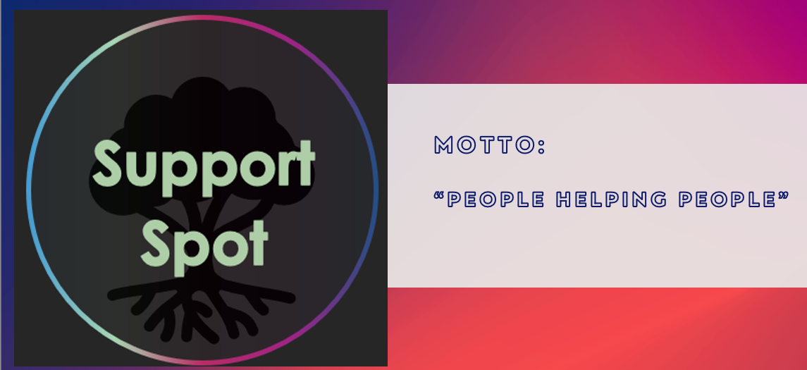

Slide 4

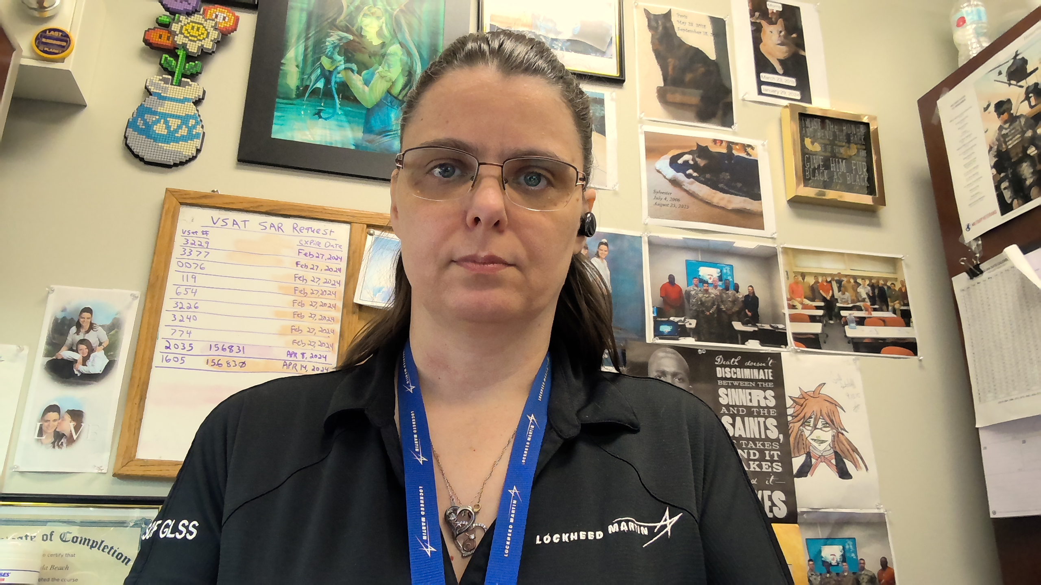
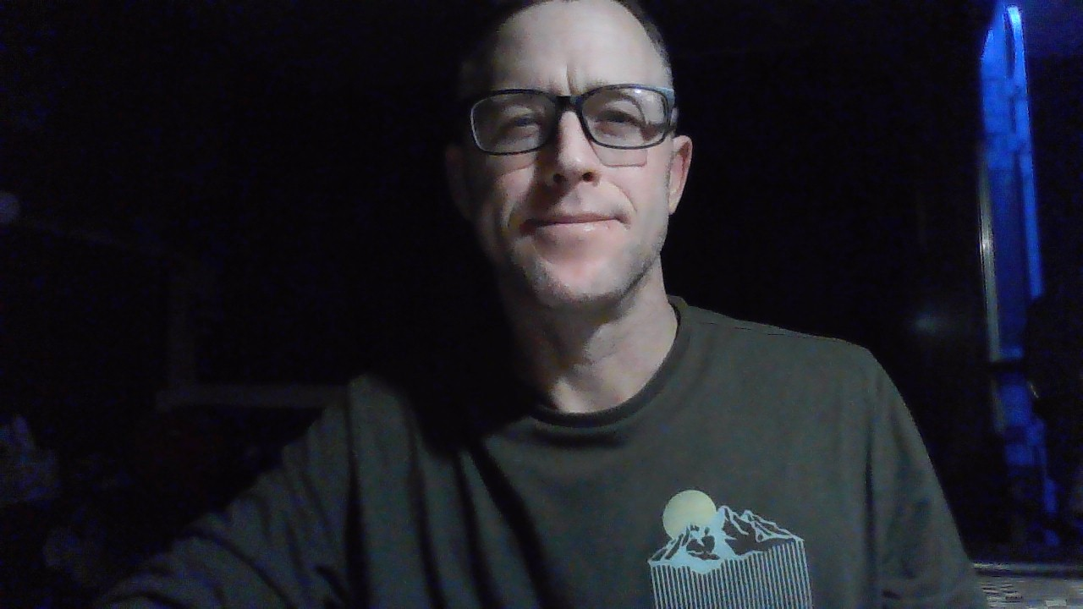

Meet the team
Jonathan Hardwick​​
Brenda Beach
Justin graves​​
Brittany smith

Slide 5
Motto: “These are the Bits You're Looking For!”

Slide 6
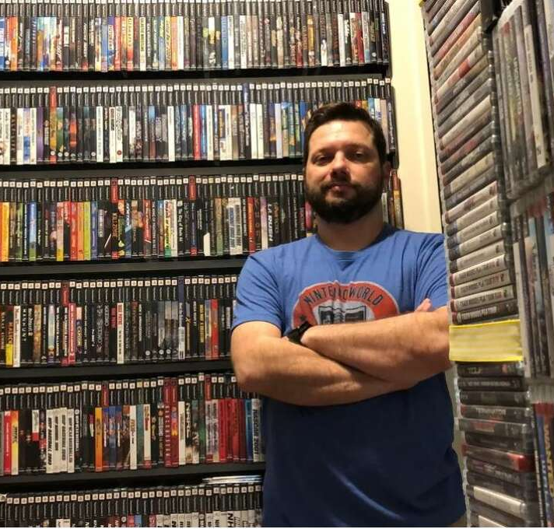
Meet Sam:
Sam has an extensive collection of video games and consoles, and he wants to create a list of his items to determine their potential worth

Slide 7
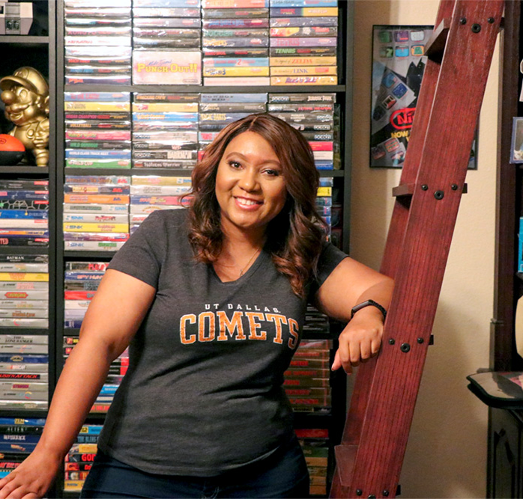
Meet Gwen:
Gwen wants to share the joy of her video game collection by selling them online.

Slide 8
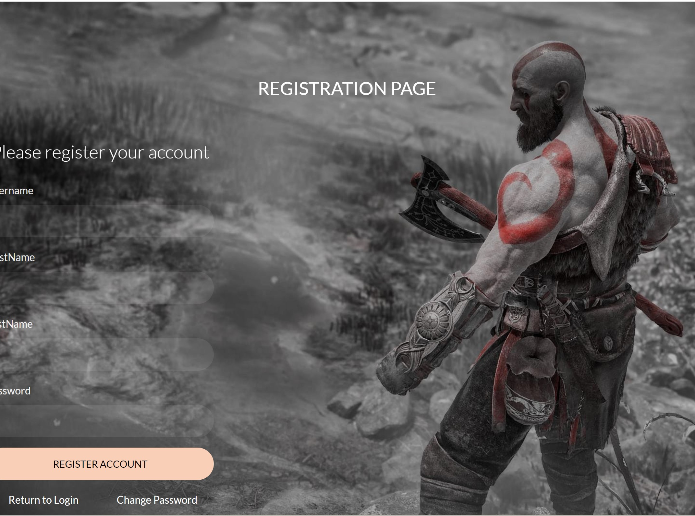
Video Game Library & Sales
User can create an account
Can create a library of all video games, consoles, and peripherals.

Slide 9
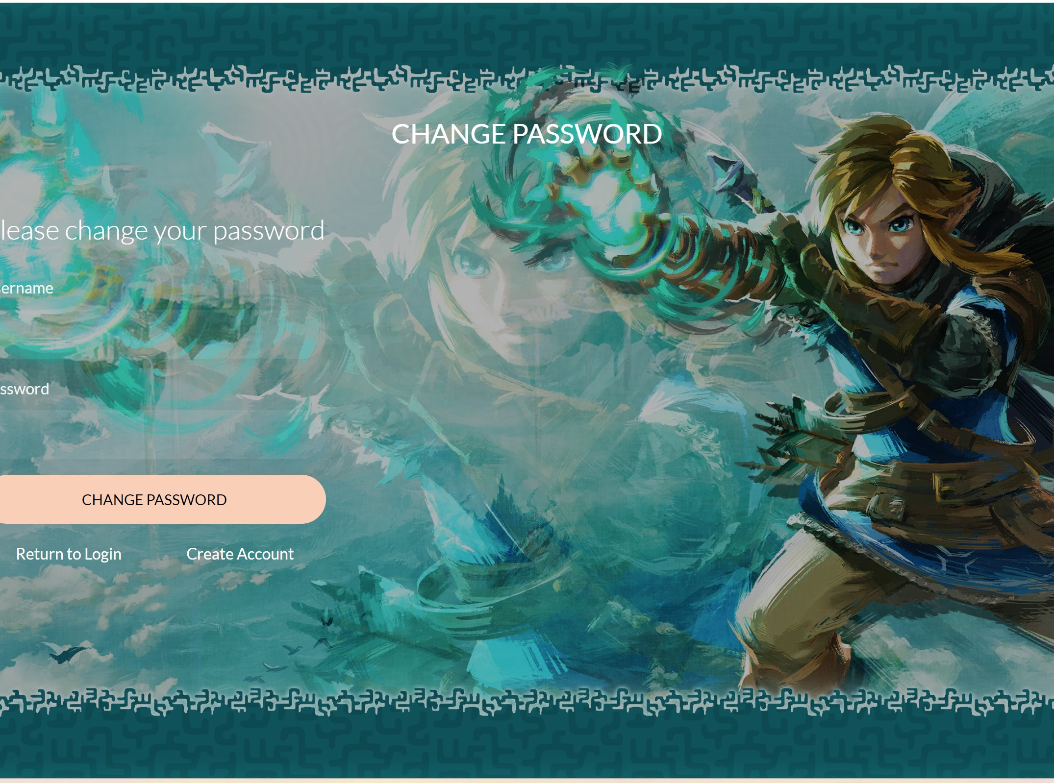
Video Game Library & Sales
If a user forgets his password, he can change it.
A user can also change his username under their account information.

Slide 10
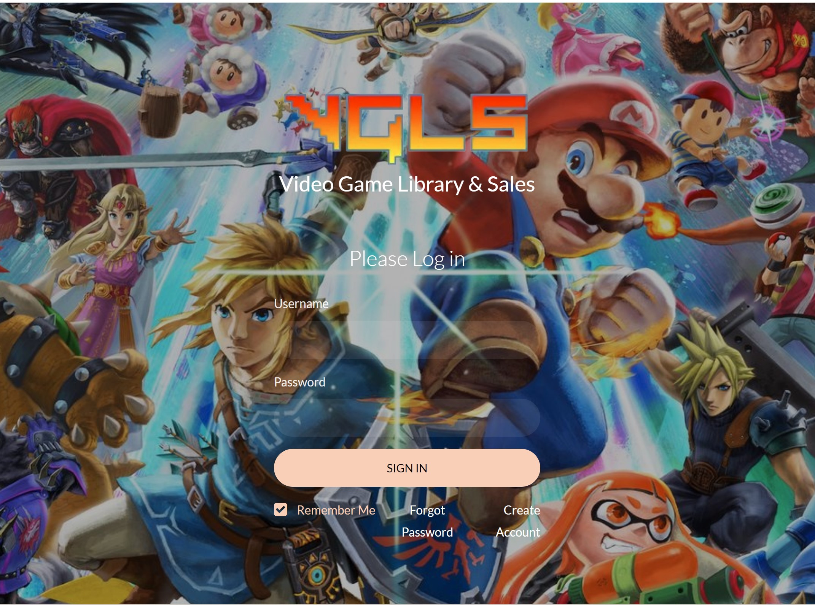
Video Game Library & Sales
The program will scrape other websites to determine the current price of the item.
The price will then be displayed in the users inventory.

Slide 11

Video Game Library & Sales
Future Plans
Allow the users to buy and sell items through the website.
Utilize an LLM to create video game recommendations to users.

Slide 12

Motto: “People Helping People”

Slide 13

The Problem:
Homeless individuals face several unique challenges when trying to get help in their community. There is a lack of stable housing and limited access to services such as mental health/ substance abuse programs. They also have difficulty accessing government assistance programs due to the lack of identification or other documentation.

Slide 14

Meet Ray:
Ray is currently living on the streets and is struggling with mental health/ substance abuse issues. He decides to reach out to a social worker for help. They then can create a localized list of resources that can help him on his journey to stable housing and recovery.

Slide 15
solution
Our mission
Target audience
At Support Spot we want to make the process of getting resources easier for people who are struggling with homelessness, substance abuse, and/or food crisis in our community.
People struggling with homelessness, mental illness/ substance abuse and food shortage.
Cost savings
Easy to use
A simple product that gives people the information they need to find the right resources for them.
Reduce costs for the client by having one program they can use to find all resources in our area.

Slide 16

Questions?

